Slide 1

Query Optimization - Indexes
Bitmap Index
TEXT
TEXT

Slide 2

Mechanism of Bitmap
With a bitmap index, a single index entry uses a bitmap to point to many rows simultaneously.
01
02
That means a bitmap index store pointers to many rows with a single index key entry.

Slide 3
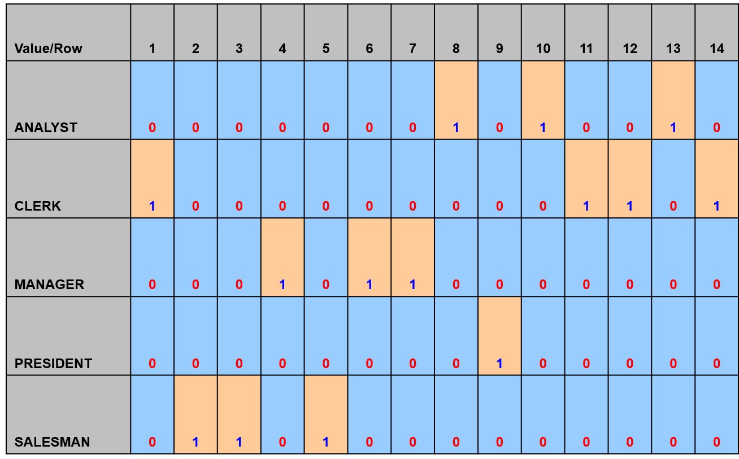
  Creating a Bitmap Index on Job column of Emp table

Slide 4
When to create Bitmap Index
1) When a column has many redundant values.
It means when there is low cardinality of values.
2) In each distinct value there are many records.

Slide 5
Bitmap Index
Let’s Explore Bitmap Index in detail.

